Slide 1





Shaping Futures: The Social Service Sector's Transformative Role in Supporting Children and Adolescents Living with HIV
Government Capacity Building and Support Program (GCBS)Webinar
August 3, 2023

Slide 2
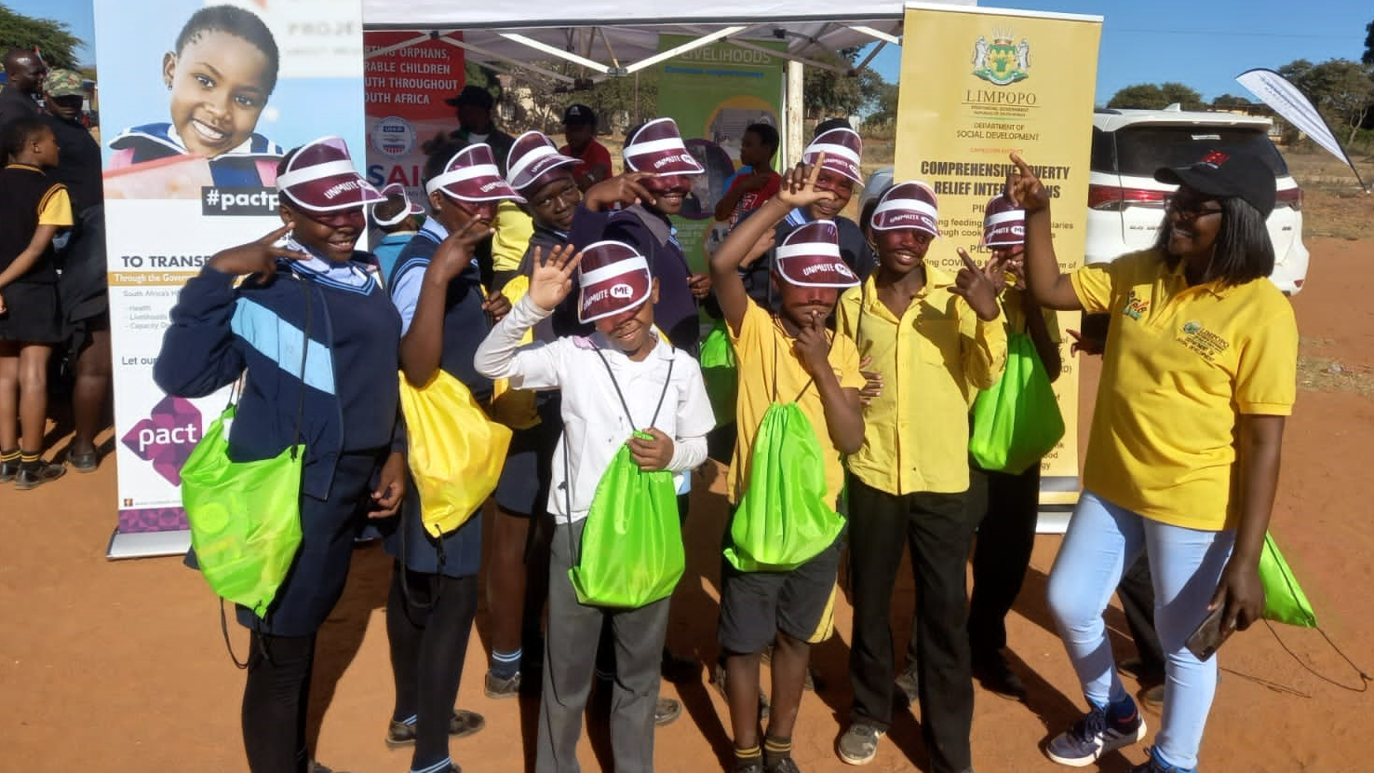
Event Overview
Opening remarks
Mr. Nkere Skosana, Chief Director, HIV and AIDS, Department of Social Development
Transforming care for vulnerable children and youth: rolling out national social service practitioners (SSP) guidelines for HIV services
Busikazi Futshane, National Department of Social Development, Deputy Director HIV Policy
Spotlighting the multidisciplinary team model developed through the implementation of SSP guidelines in Limpopo Province
Patricia Ntjie, Manager HIV & AIDS, Department of Social Development Limpopo
A social worker's experience in translating the SSP guidelines into action
Tintswalo Mitileni, Department of Social Development Social Worker, Capricorn District, Limpopo
Social service sector
response to children and adolescents living with HIV: A data snapshot
Hlengiwe Mdebuka, Pact South Africa, Regional M&E Advisor
Closing remarks
Anita Sampson, Acting Office Director, Bilateral Health Office, USAID South Africa

Slide 3
Government Capacity Building and Support Programme (GCBS) Overview
Strategic Objective 1
Strengthening services to OVCAY through high quality standardised interventions for the most vulnerable children
The GCBS programme focuses on developing the capacity of the Department of Social Development (DSD) to provide services for vulnerable children, reducing the incidence of HIV and AIDS and violence against children
The partnership started in 2013 through funding provided by USAID through the PEPFAR programme and has run for 10 years.
To achieve its three strategic objectives, GCBS provided systems strengthening support to the National DSD, developing programmatic responses that were then implemented at the provincial and district level.
The focus was to put policy, guidelines, programs into practice and in this ensuring children were provided with quality interventions.
Stand out activities included:
Risiha Case Management Program
Guidelines for Social Service Practitioners: Enabling Access to HIV Testing Services for children, adolescents and youth
Social Behaviour change programmes, YOLO and ChommY
At the height of implementation, GCBS worked with DSD service points and DSD funded Non-Profit Organizations (NPOs) across 17 districts and 7 provinces, reaching over 260 000 vulnerable children annually, with 98% of beneficiaries knowing their HIV status.
Strategic Objective 2
Strengthening inter-sector integration and coordination for improved service package
Strategic Objective 3
Improve timely availability of reliable data – using data for decision making

Slide 4
Transforming Care for Vulnerable Children and Youth: Rolling out National Social Service Practitioner Guidelines for HIV Services
Presenter: Busikazi Futshane, National Department of Social Development, Deputy Director HIV Policy

Slide 5
Background
In 2017, the Department of Social Development and GCBS identified gaps in service delivery for children and adolescents living with HIV (CALHIV) due to:
                No standardised procedures to assess children’s risk and link them to services
                Limited involvement of Social Service Practitioners (SSPs) in HIV Testing Services (HTS)
                Lack of psychosocial support as part of holistic care
                Limited ability to achieve South Africa's National Strategic Plan for TB, HIV, STIs goals towards 95-95-95

Slide 6
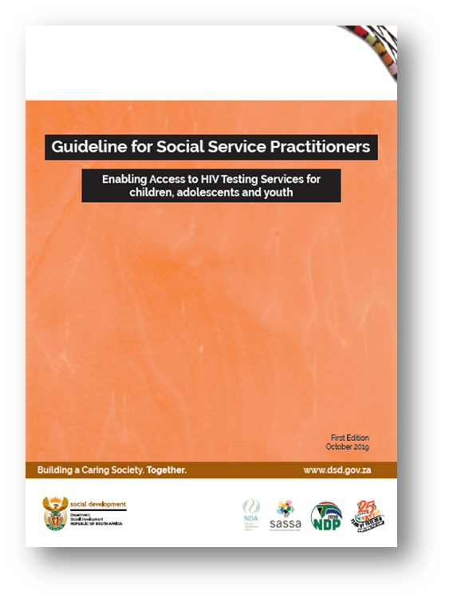
Development of the
National Guideline for Social Service Practitioners
  In response to the National Strategic Plan for HIV and AIDS, TB and STIs 2017-2022, DSD with the support of GCBS, developed guidelines in 2019 to:
  Respond to the departmental mandate of providing prevention, early intervention, and support services to children who need HIV testing and support services
  Position SSPs to effectively respond to HIV by developing their competencies and skills
  Elevate the role of psychosocial support
  Ensure early identification of orphans and vulnerable children, adolescents, and youth (OVCAY) at highest risk of HIV through risk assessments and link them to HIV testing services and access to treatment
  Contribute to 95-95-95 targets and the road to Undetectable=Untransmittable

Slide 7

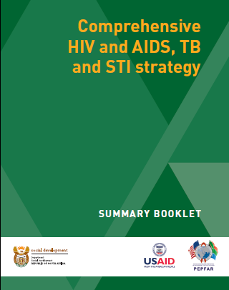
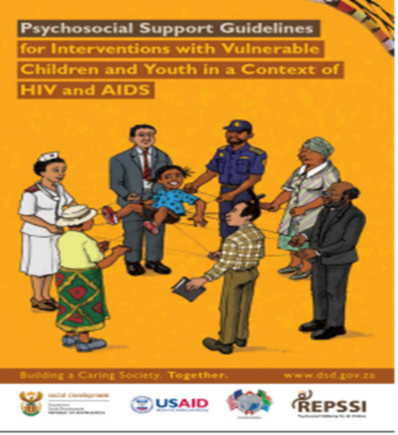
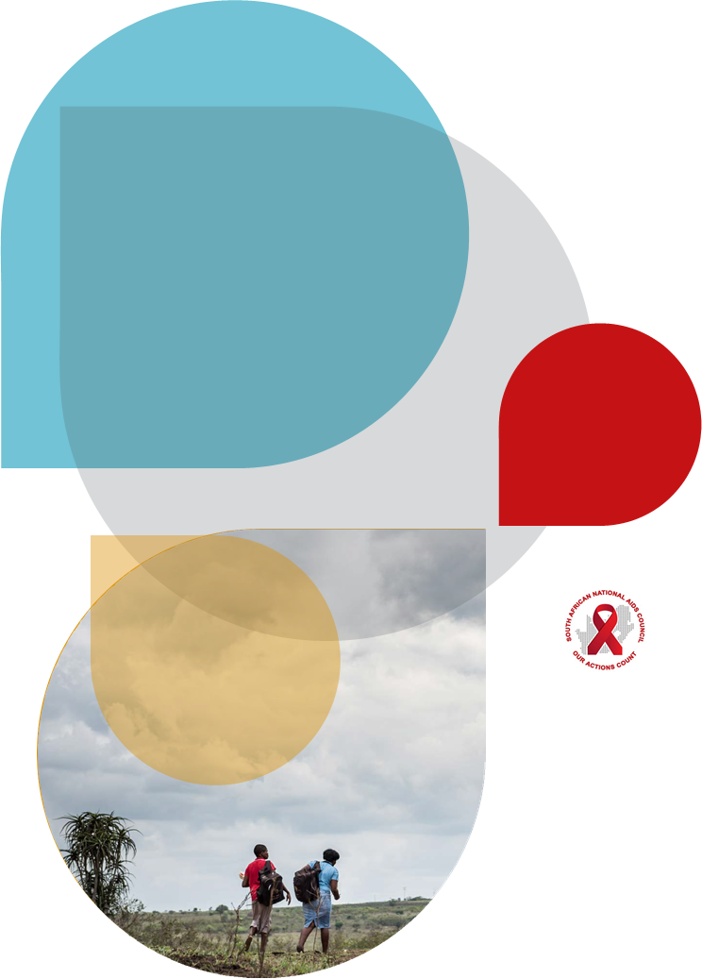

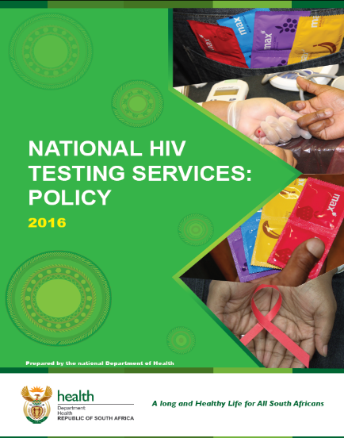
Other national guiding policies and strategies

Slide 8
Translating guidelines into action
Trainings conducted throughout the country using a Train the Trainer (ToT) approach to sensitize SSPs on issues of HIV from 2019, setback in 2020 due to the COVID pandemic.
Registered with the South African Council for Social Service Practitioners (SACSSP) for continuous professional development (upon completion of training, SSPs receive continuous professional development points).
DSD included capacity development indicators on the guidelines in its annual performance plan to ensure guidelines translated to direct service delivery to support CALHIV
Out of South Africa's 52 districts, SSPs in 27 high burdened districts have been trained on the guidelines.
After trainings, DSD provided intensive support in collaboration with GCBS to strengthen implementation of the guidelines in targeted districts.
The focus of this support included strengthening psychosocial support interventions; case management; addressing human rights violations; strengthening referrals and linkages, and to improving reporting.

Slide 9
Key observations during rollout
  Challenges raised
  HIV still viewed as a biomedical issue and the role of DSD needed to be elevated
  Lack of knowledge of the legal and policy documents for the implementation of the guidelines
  Lack of support from supervisors and managers
  Fears, attitude, and confidence issues among SSPs to address HIV issues
  Lack of knowledge on basic HIV medical terms
  Opportunities identified
  Every SSP needs to be trained on the guidelines
  Multi-disciplinary efforts achieve better results
  Disclosure is essential for SSPs to provide HIV support
  Self-knowledge and understanding are integral for provision of psychosocial support

Slide 10
Acknowledgements
The development and roll-out of the National Guideline for SSPs on HIV Services
has successfully positioned DSD as an active partner in the fight against HIV in South Africa.
This achievement is aided by:
GCBS technical support and resources and continuous joint efforts
Partnerships and collaboration with other sectoral departments and partners

Slide 11


Slide 12
Spotlighting the multidisciplinary team model developed through the implementation of SSP Guidelines in Limpopo Province
Presenter: Patricia Ntjie,
Manager HIV & AIDS, Department of Social Development Limpopo

Slide 13
Background in Capricorn District
Capricorn is one of the districts within Limpopo and it is one of the 27 PEPFAR priority districts due to its high HIV burden
In 2022, 74% of CALHIV in Limpopo Province knew their status; of those, 69% were on treatment; and of those, 61% were virally suppressed
Even though SSPs were trained on the Guidelines for SSPs, implementation was still a challenge at DSD service points
Poor integration and referrals for HIV testing services due to siloed service delivery by health practitioners and SSPs
Lack of stakeholder involvement hampered the integrated implementation of the guidelines.

Slide 14
Multidisciplinary team (MDT) Model
The aim of the MDT model is to ensure continuity of care for CALHIV through case conferencing, bi-directional referrals, and integrated comprehensive case management.
DSD and GCBS trained SSPs on guidelines; SSPs receive on-site support and mentoring from GCBS
Establishment of MDTs with DSD, GCBS, ANOVA (clinical partner), Department of Health
Signed MOU between GCBS and ANOVA
Developed schedules, agendas, and reporting and feedback mechanisms
Defined roles and responsibilities of partners on the MDT
Developed processes and tools for the MDT to conduct case conferencing

Slide 15
Coordination Mechanisms and Referral Pathways in Supporting CALHIV
Department of Health
Provides test and treat
Enrolls CALHIV into ART and supports adherence
Monitors viral load and shares information with partners
Refers CALHIV with treatment interruption for tracking and tracing for reinitiating into ART
Department of Social Development
Refers children in foster care for HTS
Assists with tracing CALHIV with treatment interruption
Provides psychosocial support, disclosure counselling, and adherence support
Clinical Partner (ANOVA)
Provides HIV clinical services
Provides lay-counselling
Manages adherence support groups
Strengthens linkages between health and OVC partners

Slide 16
Missed Appointments at Baseline, Tracing, and Re-initiation on ART
Primary Health Care Facility Name | # of CALHIV recorded | 1st MDT meeting | 2nd MDT meeting | # of CLHIV re-initiated | % re-initiated
Buffelshoek Clinic | 100 | 14 | 7 | 7 | 50%
A Mamabolo Clinic | 47 | 1 | 0 | 1 | 100%
Makanye Clinic | 106 | 17 | 9 | 8 | 47%
Nthabiseng Clinic | 26 | 4 | 3 | 1 | 25%
Total | 279 | 36 | 19 | 17 | 47%

Slide 17
Monitoring progress of viral load suppression
through MDTs

Slide 18
Lessons learned from Limpopo
Effective provision of HIV services requires consistent, well-coordinated integrated interventions by all key stakeholders.
Involvement of social workers in MDTs enables access to psychosocial support by CALHIV and families for improved adherence to treatment and increased viral load suppression.
Continuous implementation of the SSP Guidelines for HIV Services enables access to HTS for CALHIV and comprehensive services through the MDTs to contribute to 95-95-95 targets in Capricorn District.
A common goal amongst partners led to the success of the MDT model as it enables improved access to ART and increased viral suppression.

Slide 19
A Social Worker’s Experience in Translating the SSP Guidelines into Action
Presenter: Tintswalo Mitileni, Department of Social Development Social Worker at Ziest Clinic in Blouberg Municipality, Capricorn District, Limpopo

Slide 20
• I have been a DSD social worker in Limpopo, Capricorn District since 2009.
• Before SSP guidelines were rolled out, I placed children in foster care without assessing their health, including HIV status.
• In 2019 I was trained on the SSP Guideline and then assessed all the 35 children in my caseload for HIV risk and HIV services needs.
• I discovered one CALHIV age 16 years with high viral load due to non-adherence and non-disclosure.
• I supported the caregiver to disclose to the child her HIV status and provided cognitive behavioral therapy and encouraged ART adherence.
• As a result of my support, CALHIV's viral load decreased from 4,376 to 39 copies, achieving viral load suppression.
In 2021 the child is thriving and continuing their education at a tertiary institution.
I continue to support the child to stay on treatment through virtual case management.
• My experience showed me how SSP interventions contributed to Capricorn District's progress towards 95-95-95 target.
MY STORY

Slide 21
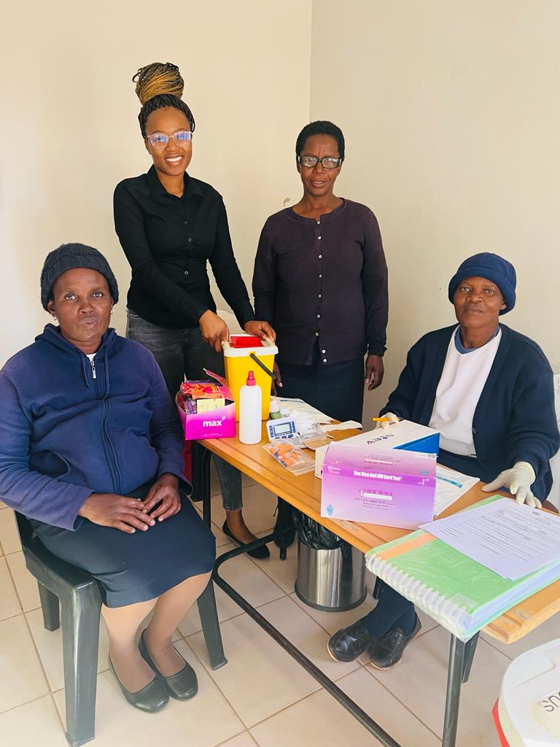

Slide 22
Social Service Sector Response to Children and Adolescents Living with HIV- A Data Snapshot
Presenter: Hlengiwe Mdebuka, Pact South Africa, Regional M&E Advisor

Slide 23
Snapshot FY18 to FY 23
HIV testing and treatment cascade for beneficiaries (<18yrs) in GCBS supported districts and sites
Guidelines for SSPs rolled out
Guidelines for SSPs piloted
Guidelines for SSPs developed
 | FY18 | FY19 | FY20 | FY21 | FY22 | FY23
Total <18yrs | 12,4967 | 155,307 | 73,090 | 93,144 | 46,220 | 24,292
OVCY with known HIV status | 13,900(11%) | 88,307(57%) | 69,051(94%) | 87,219(94%) | 44,600(96%) | 23,826(98%)
OVCY with HIV positive status | 739(5%) | 5,448(6%) | 8,975(13%) | 21,810(25%) | 16,437(36%) | 8,496(37%)
CALHIV on ART | 628(85%) | 5,448(100%) | 8,975(100%) | 21,808(100%) | 16,437(100%) | 8,496(100%)
CALHIV with reported viral load | _ | _ | _ | _ | 11,660(71%) | 8,077(95%
CALHIV with suppressed VL | _ | _ | _ | _ | 9,587(81%) | 6,661(82%)

Slide 24
Summary
The Department of Social Development with the support of the GCBS programme embraced its role in the HIV space.
This change was demonstrated by the development of Guidelines for SSPs which provided support and mandate to provinces to focus on HIV prevention and support services for children and adolescents.
Data presented indicate a systems change approach adopted by the Department and this data would not be available if the guidelines were not implemented.
The use of data informed interventions leading to partnering with clinical partners for successful case finding and linkages towards viral suppression.

Slide 25
Closing remarks
Thank you

